Slide 1





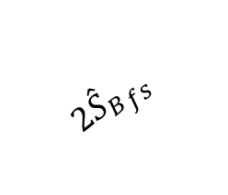





$| {{2\hat{S}}_{B}}_{fs }+{{\hat{S}}_{C}}_{fs }|$
$| {{2\hat{S}}_{B}}_{fs }$-${{\hat{S}}_{C}}_{fs }|$
$$β$$
$${{\hat{S}}_{C}}_{fs }$$
$${{\hat{S}}_{ABC}}_{fs }$$
$${{2\hat{S}}_{B}}_{fs }$$
$$φ$$
$$α$$
$${{\hat{S}}_{A}}_{fs }$$
(a)
(b)
(c)
$$α=φ_{C−B}−φ_{C−A}$$
$$β=φ_{C−C}−φ_{C−B}$$

Slide 2

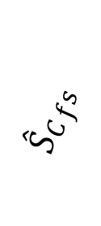

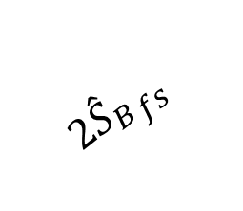





$$β$$
$${{\hat{S}}_{C}}_{fs }$$
$${{\hat{S}}_{ABC}}_{fs }$$
$${{2\hat{S}}_{B}}_{fs }$$
$$φ$$
$$α$$
$| {{2\hat{S}}_{B}}_{fs}+{{\hat{S}}_{C}}_{fs }|$
$${{\hat{S}}_{A}}_{fs }$$
(a)
$| {{2\hat{S}}_{B}}_{fs}$-${{\hat{S}}_{C}}_{fs }|$
(b)
(c)

Slide 3
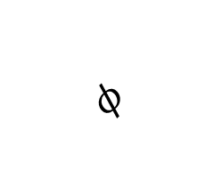




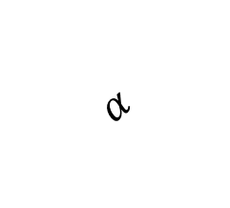



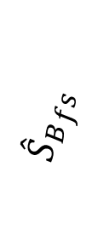
$$α$$
$${{\hat{S}}_{B}}_{fs }$$
$${{\hat{S}}_{A}}_{fs }$$
$${{\hat{S}}_{B}}_{fs }$$
$${{\hat{S}}_{A}}_{fs }$$
$$φ$$
$$α$$
$$φ$$
$${{\hat{S}}_{AB}}_{fs }$$
$${{\hat{S}}_{AB}}_{fs }$$
(a)
(b)

Slide 4

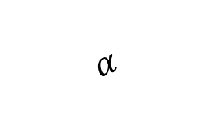
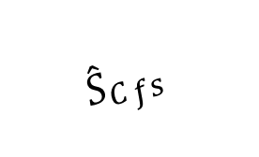



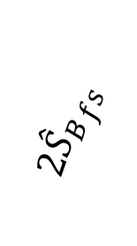


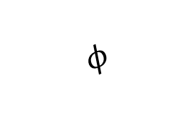

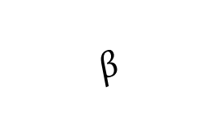


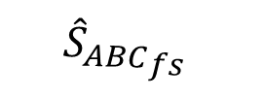
$$β$$
$$β$$
$${{2\hat{S}}_{B}}_{fs }$$
$$α$$
$${{\hat{S}}_{C}}_{fs }$$
$${{2\hat{S}}_{B}}_{fs }$$
$${{\hat{S}}_{A}}_{fs }$$
$${{\hat{S}}_{A}}_{fs }$$
$$α$$
$$φ$$
$$φ$$
$${{\hat{S}}_{ABC}}_{fs }$$
$${{\hat{S}}_{ABC}}_{fs }$$
(a)
(b)
$| {{2\hat{S}}_{B}}_{fs}+{{\hat{S}}_{C}}_{fs }|$
$| {{2\hat{S}}_{B}}_{fs}$-${{\hat{S}}_{C}}_{fs }|$
(c)
(d)

Slide 5




$$m_{a}=0$$
$$m_{a}=0.3$$
$$m_{a}=0.6$$
$$m_{a}=0.9$$

Slide 6




$$m_{a}=0$$
$$m_{a}=0.3$$
$$m_{a}=0.6$$
$$m_{a}=0.88$$

Slide 7




$$m_{a}=0$$
$$m_{a}=0.35$$
$$m_{a}=0.7$$
$$m_{a}=0.97$$

Slide 8






$$m_{a}=0$$
$$m_{a}=0.3$$
$$m_{a}=0.9$$
$$m_{a}=0.6$$
$$m_{a}=0.95$$
$$m_{a}=1$$

Slide 9
$$m_{a}=0$$
$$m_{a}=0.3$$
$$m_{a}=0.9$$
$$m_{a}=0.6$$
$$m_{a}=0.95$$
$$m_{a}=1$$

Slide 10
(a)
(b)

Slide 11
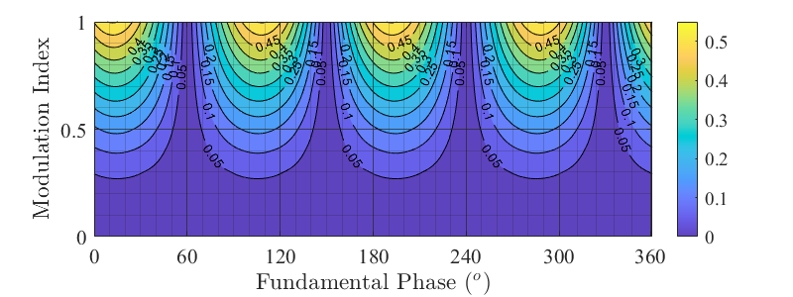
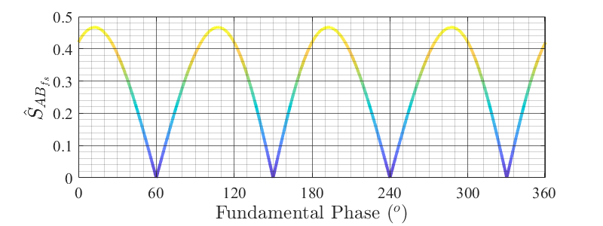
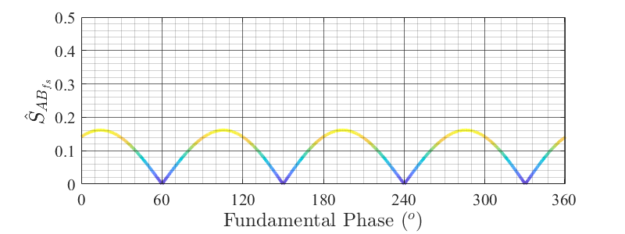


(a)
$$m_{a}=0.9$$
(b)
$$m_{a}=0.5$$
(c)

Slide 12


$$Q_{A}$$
$$Q_{B}$$

Slide 13
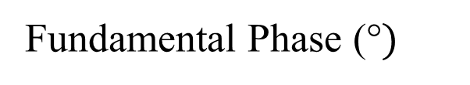


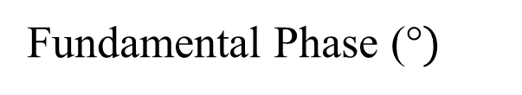



$$V_{Ref_{A}}=m_{a}sin(θ_{f})$$
$$V_{Ref_{B}}=m_{a}sin(θ_{f}−{120}^{o})$$
$$V_{Ref_{C}}=m_{a}sin(θ_{f}+{120}^{o})$$
$$Q_{A}$$
$$Q_{B}$$
Modulation Index
Digital Gate Signals
Fundamental Phase (°$)$
Fundamental Phase (°$)$
Notes:
Fundamental Phase

Slide 14








$V_{Ref_{A}}={0.8660 m}_{a}$ = 0.5196
$$V_{Ref_{B}}=0$$
$$V_{Ref_{C}}={−0.8660 m}_{a}=0.5196$$
$V_{Ref_{A}}=0 m_{a}$ = 0
$$V_{Ref_{B}}=1 m_{a}=0.6$$
$$V_{Ref_{C}}={−0.8660 m}_{a}=0.5196$$
$$Q_{A} (θ_{f}={120}^{o})$$
$$Q_{B}=(θ_{f}={180}^{o})$$

Slide 15








$V_{Ref_{A}}={0.8660 m}_{a}$ = 0.5196
$$V_{Ref_{B}}=0$$
$$V_{Ref_{C}}={−0.8660 m}_{a}=0.5196$$
$V_{Ref_{A}}=0 m_{a}$ = 0
$$V_{Ref_{B}}=1 m_{a}=0.6$$
$$V_{Ref_{C}}={−0.8660 m}_{a}=0.5196$$
$$Q_{A}$$
$$Q_{B}$$

Slide 16


$$Q_{A} (θ_{f}={120}^{o})$$
$$Q_{B}=(θ_{f}={180}^{o})$$

Slide 17


$$Q_{A} (θ_{f}={120}^{o})$$
$$Q_{B}=(θ_{f}={180}^{o})$$

Slide 18
$$Q_{A} (θ_{f}={120}^{o})$$
$$Q_{B}=(θ_{f}={180}^{o})$$

Slide 21


$$Q_{A}$$
$$Q_{B}$$

Slide 22


$$Q_{A}$$
$$Q_{B}$$

Slide 23
A WPT system is connected between leg-A and leg-B, and the WPT system is supposed to be excited by the switching harmonic.
For each switching interval, the duty cycle of leg-A and leg-B varies, and their average values equal the corresponding reference voltages at each time interval.
Thus, varying duty cycles follow a sinusoidal reference signal, which drives the motor. However, the changing duty cycles cause a fluctuation in the magnitude of the switching component.
The fluctuation can also be analyzed in the frequency domain and modeled as sideband harmonics.
Due to this fluctuation, the input voltage of the WPT system changes over the fundamental period.
This input voltage fluctuation also echoes the output voltage of the WPT system, and it should be mitigated.
The first solution is using an active converter at the output side, which increases the cost and complexity of the system.
Besides, it increases the weight of the rotating side.
The second solution is connecting bulky capacitance to the output in parallel, increasing the weight and creating a point of failure.
The third solution is using a control method such as frequency detuning. However, the output current is measured and controlled in the field excitation system.
A lag exists due to the high inductance of the field, and the frequency control cannot deal with the fluctuation if phase compensation circuits or algorithms are not applied.
Instead of solving this fluctuation on the output side, the input side solutions can be proposed.
However, these solutions should not affect the average value, which follows the reference signal.

